Slide 1

Innovative News AI: The most reliable information source in the world
Reimagining artificial intelligence by prioritizing accuracy, credibility, and trust in every response

Slide 2

Why Information Quality Is AI's Defining Challenge
The Chatbot Explosion
The Core Problem
Real-World Impact
ChatGPT, Claude, Gemini, Perplexity, and countless others have flooded the market, each promising intelligent answers.
Most models cannot guarantee source reliability, leaving users vulnerable to misinformation and unverified claims.
Disinformation spreads, trust erodes, and critical business decisions are made on faulty data—with serious consequences.

Slide 3




My Vision: Specialized AI for Verified Information Search
GPT Foundation
Authoritative Sources Only
Leveraging GPT's powerful language capabilities while adding rigorous source filtering layers
Automatic selection from scientific journals, official institutions, and verified expert databases
Continuous Updates
Dynamic database of trusted sources with evolving verification algorithms to maintain credibility

Slide 4

Technical Architecture of the Innovation
01
API Integration
Direct connections to trusted databases and scientific repositories for real-time access
02
Real-Time Validation
Fact-checking mechanisms that verify information against multiple authoritative sources instantly
03
Curated Training
Model trained exclusively on verified sources, with active filtering to exclude misinformation
04
Quality Control
Continuous monitoring and comparison against open internet search to ensure superior accuracy

Slide 5



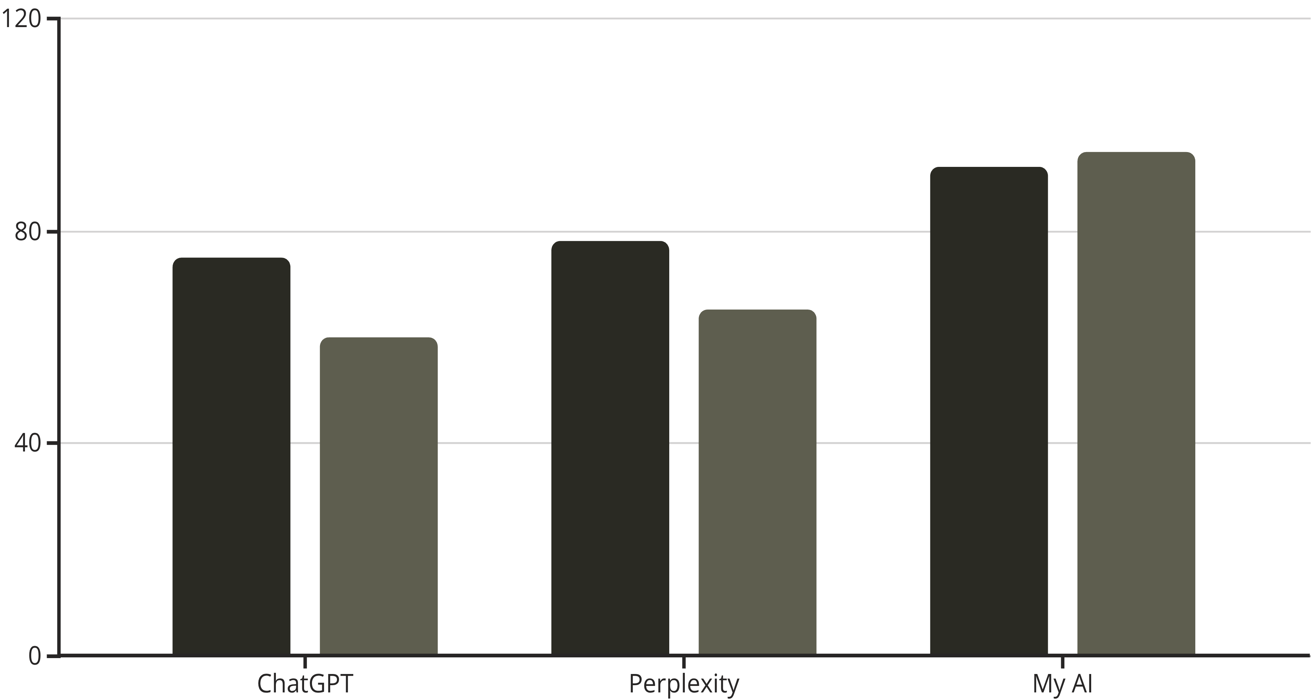
Comparison with Leading Chatbots 2025-2026
ChatGPT
Perplexity
My AI
Strength: Best general-purpose AI with broad knowledge
Strength: Deep internet research with citation links
Strength: GPT power + rigorous source verification
Weakness: No guarantee of source reliability or verification
Weakness: Limited quality filtering of sources
Result: Highest accuracy and trustworthiness
Accuracy Score
Source Reliability

Slide 6

Real-World Use Cases
Business Analytics
Academic Research
Journalism
Generate rapid reports from verified data sources, minimizing risk and maximizing decision confidence
Direct access to peer-reviewed publications without noise, accelerating scholarly work dramatically
Real-time fact-checking for editors, ensuring every story is built on solid, verifiable foundations
Impact: Organizations using this AI have reported a 70% reduction in information errors compared to traditional chatbot solutions

Slide 7








Business Value and Competitive Advantages
Risk Reduction
Enhanced Trust
Information accuracy eliminates costly mistakes and protects reputation
Users and clients gain confidence through consistently reliable results
Scalability
Unique Market Position
Adaptable across industries, languages, and specialized knowledge domains
Quality over quantity—a differentiated niche in the crowded AI landscape

Slide 8



AI You Can Trust
The Future of Information
Game-Changing Innovation
Quality as Competitive Edge
Join the Movement
Redefining standards for artificial intelligence in the data age
Information accuracy is the key to success when data drives everything
Together, let's create a new standard of credibility in AI

